Slide 1

Feature-based Sentiment Analysis of Customer Reviews

Slide 2
Customer Review
“ Good quality phone due to glass body gorilla Glass 5 protection back and front. Camera are very good. 48 mp rear camera available. The fingerprint sensor is not that good though. 4500 mah long battery give amazing backup. The Interstellar black color is my favourite. Go for it. ”
Notes:
Bang for the buck
Cheaper phones are getting better with Xiaomi in the driver seat
Redmi note 8 pro have premium build quality and a great processor
Smooth n extreme gameplay on pubg is a piece o cake for this beast.
Great battery backup
Moderate heating is there when gaming crosses 30 to 40min mark (common for every Phone)
I got this phone in 9910 in exchange offer or icici credit card offer i am happy to buy this
Great value for money.
I have purchased only for camera purpose, it fullfill my expectations.
64 mp camera
4k 30 fps
FHD 30/60/120 fps
720p 240 fps
Cons.
Night mode is not upto the mark
Wide angle camera quality is poor
Video stabilization is not so good

Slide 3
Non-opinionated phrases
“ Good quality phone due to glass body gorilla Glass 5 protection back and front. Camera are very good. 48 mp rear camera available. The fingerprint sensor is not that good though. 4500 mah long battery give amazing backup. The Interstellar black color is my favourite. Go for it. ”

Slide 4
Opinionated phrases on features
“ Good quality phone due to glass body gorilla Glass 5 protection back and front. Camera are very good. 48 mp rear camera available. The fingerprint sensor is not that good though. 4500 mah long battery give amazing backup. The Interstellar black color is my favourite. Go for it. ”
Notes:
Bang for the buck
Cheaper phones are getting better with Xiaomi in the driver seat
Redmi note 8 pro have premium build quality and a great processor
Smooth n extreme gameplay on pubg is a piece o cake for this beast.
Great battery backup
Moderate heating is there when gaming crosses 30 to 40min mark (common for every Phone)
I got this phone in 9910 in exchange offer or icici credit card offer i am happy to buy this
Great value for money.
I have purchased only for camera purpose, it fullfill my expectations.
64 mp camera
4k 30 fps
FHD 30/60/120 fps
720p 240 fps
Cons.
Night mode is not upto the mark
Wide angle camera quality is poor
Video stabilization is not so good

Slide 5
Opinionated phrases but not on features
“ Good quality phone due to glass body gorilla Glass 5 protection back and front. Camera are very good. 48 mp rear camera available. The fingerprint sensor is not that good though. 4500 mah long battery give amazing backup. The Interstellar black color is my favourite. Go for it. ”
Notes:
Bang for the buck
Cheaper phones are getting better with Xiaomi in the driver seat
Redmi note 8 pro have premium build quality and a great processor
Smooth n extreme gameplay on pubg is a piece o cake for this beast.
Great battery backup
Moderate heating is there when gaming crosses 30 to 40min mark (common for every Phone)
I got this phone in 9910 in exchange offer or icici credit card offer i am happy to buy this
Great value for money.
I have purchased only for camera purpose, it fullfill my expectations.
64 mp camera
4k 30 fps
FHD 30/60/120 fps
720p 240 fps
Cons.
Night mode is not upto the mark
Wide angle camera quality is poor
Video stabilization is not so good

Slide 6
Features
Opinion
Score
Phone quality
Camera
Fingerprint sensor
Battery Backup
Good
Very good
Not good
amazing
+1
+2
-1
+3
Notes:
Bang for the buck
Cheaper phones are getting better with Xiaomi in the driver seat
Redmi note 8 pro have premium build quality and a great processor
Smooth n extreme gameplay on pubg is a piece o cake for this beast.
Great battery backup
Moderate heating is there when gaming crosses 30 to 40min mark (common for every Phone)
I got this phone in 9910 in exchange offer or icici credit card offer i am happy to buy this
Great value for money.
I have purchased only for camera purpose, it fullfill my expectations.
64 mp camera
4k 30 fps
FHD 30/60/120 fps
720p 240 fps
Cons.
Night mode is not upto the mark
Wide angle camera quality is poor
Video stabilization is not so good

Slide 7
Phone quality
Camera
{ good, amazing, bad, wonderful, worse ….
Score - 83%
{ awesome, great, not good, so bad, ……..
Score - 90%
Notes:
Bang for the buck
Cheaper phones are getting better with Xiaomi in the driver seat
Redmi note 8 pro have premium build quality and a great processor
Smooth n extreme gameplay on pubg is a piece o cake for this beast.
Great battery backup
Moderate heating is there when gaming crosses 30 to 40min mark (common for every Phone)
I got this phone in 9910 in exchange offer or icici credit card offer i am happy to buy this
Great value for money.
I have purchased only for camera purpose, it fullfill my expectations.
64 mp camera
4k 30 fps
FHD 30/60/120 fps
720p 240 fps
Cons.
Night mode is not upto the mark
Wide angle camera quality is poor
Video stabilization is not so good

Slide 8
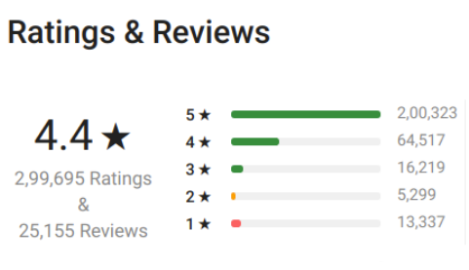
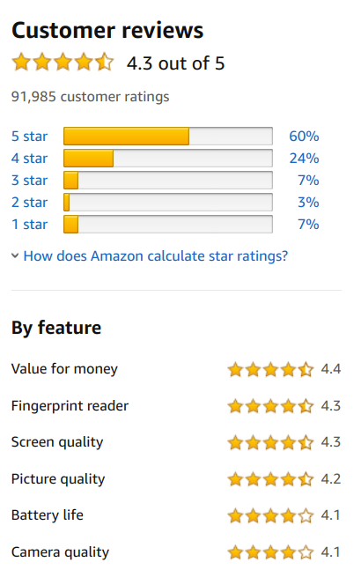
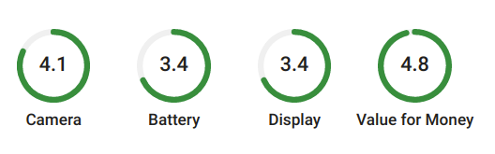
Flipkart
Amazon
Team Manager
Notes:
We present a way to improvise on this and get many more features.

Slide 9
Pipeline
Preprocessing dataset
Feature Extraction
Opinion mining

Slide 10
Preprocessing techniques

Slide 11
Lowercasing dataset
Demojification
Remove one word reviews
Remove two word reviews not having noun-adjective pair

Slide 12
The problem of feature extraction

Slide 13
Rear camera
Display
Phone (Root)
Battery backup
Battery
Phone
Notes:
Only two word feature to be extracted

Slide 14
Explicit vs Implicit feature
Explicit feature :
“ The battery backup is good. “
Implicit feature:
“ Not worth spending on this phone. Don’t buy. “
Not value of money

Slide 15
Incorrectly written features :
“ The camara clicks amazing pictures. “
“ The betteri backup is not efficient. “

Slide 16
Process Flow
Part of Speech tagging - All features are tagged as noun and noun phrases.
Feature extraction - Only frequently mentioned features are extracted.
Feature pruning - Meaningful features are selected.
Spelling correction - Misspelled nouns are converted to the corresponding features.

Slide 17
POS tagging - Nouns
“ Good quality phone due to glass body gorilla Glass 5. Camera are very good. 48 mp rear camera available. The fingerprint sensor is not that good though. “
All features are tagged as nouns.
All nouns are not features.

Slide 18
Feature extraction
Association rules mining using Apriori algorithm
Support = Number of reviews noun occurs in / Number of total reviews
The maximum feature length = 2
Camera Battery camera
Awesome Phone budget
Battery Battery life
Notes:
Max feature length = 2 words, only grammatically correct nouns to be extracted as features

Slide 19
Feature Pruning
Compactness Pruning - For two word features
Compact if word distance <=3 and no conjunction and punctuation in between the words.
M_support = Total sentences where compact / Total sentences where they occur together
If M_support greater than threshold, candidate feature -> meaningful feature
“ The battery and camera are both great. “
“The battery life is amazing. “

Slide 20
Feature Pruning
Redundancy Pruning - For one word feature
Superset of ‘camera’ = { ‘rear camera’, ‘’front camera’, ‘camera quality’ ….}
P_support = Total sentences where no superset of the feature occurs and the feature occurs alone
If P_support greater than threshold, candidate feature -> meaningful feature
“ The rear camera is awesome.”
“ The camera is not so good. “

Slide 21
Spelling Correction of nouns
If Levenshtein distance (noun, meaningful feature) = 1
Noun => meaningful feature
“ The camara clicks amazing pictures. “
is treated as
“ The camera clicks amazing pictures. “

Slide 22
The problem of opinion mining

Slide 23
Explicit vs Implicit opinion
Explicit opinion:
“ The battery backup is good. “
Implicit opinion:
“Too big to fit into pocket.”
Negative opinion towards size

Slide 24
Process Flow
Opinion extraction
Sentiment scoring

Slide 25
Opinion Extraction
“ The phone has good battery. “ Before feature
“ The camera is not working properly. “ After feature
Take nearest opinion to the feature

Slide 26
Opinion words
Adjective
Verb
Adj+Adj pair
Adv/Neg+Adj
Adv/Neg+Verb
Verb+Adj
Great awesome absolutely amazing not working works good
Extract the nearest phrase

Slide 27
Sentiment scores using VADER
{ 'compound': 0.4404, 'neg': 0.0, 'neu': 0.508, 'pos': 0.492 }
Score = ( total pos) / ( total neg + total pos)

Slide 28
Sentiment scores using VADER
Adjective + Adjective
Adverb/Negation + Adjective
Verb + Adjective
Verb + Adverb (some cases)

Slide 29
Sentiment scores
Negation + Verb ( “ The fingerprint sensor doesn’t work.“ )
Verb + Adverb ( “ Camera is not working properly.” )
If any negation word and VADER score[‘neg’] = 0.0, then
Score = { ‘pos’ = 0.0, ‘neg’ = 0.25, ‘compound’ = -0.25 }

Slide 30
Results

Slide 31
Feature list
One word features
Battery Camera
Mobile Processor
Problem Price
Redmi Quality
Product
Two word features
battery backup Battery life
Finger print Camera quality
Finger sensor Redmi Note
Gaming experience Phone price
Note Pro

Slide 32
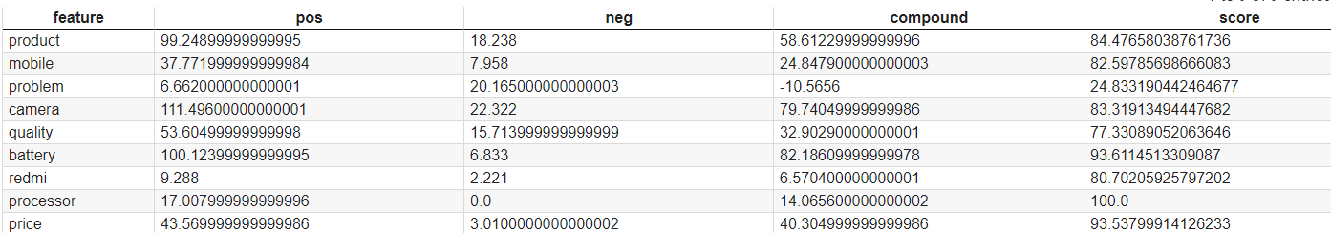
Total sentiment score of one word features

Slide 33
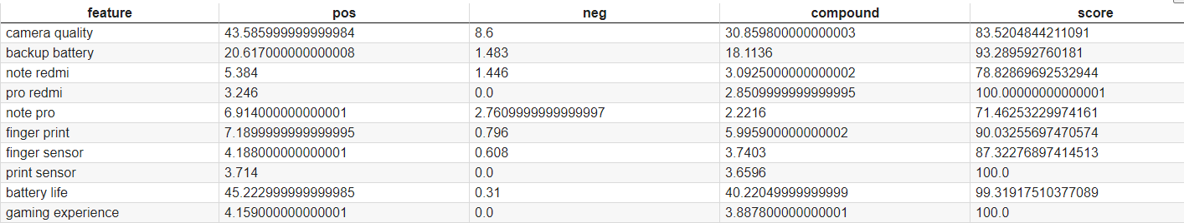
Total sentiment score of two word features

Slide 34
Whole pipeline
Preprocessing review dataset
Feature extraction
Opinion mining
Lowercase
Demojify
Remove 1 word feature
Remove 2 word features with no noun-adjective pair
POS tagging
Frequent feature extraction using Apriori algorithm
Feature pruning to get meaningful list of features
Correction of mis-spelled nouns to corresponding feature
Extracting opinion phrases for features
Scoring the opinion phrases and getting total sentiment score for a feature

Slide 35
Thank You !!

